Slide 1


DATABASE-BACKED CLINIC MANAGEMENT APPLICATION
Clinic Management
System
Engine
MySQL 8.0
Core Focus
Fundamentals of Databases
Scheduling, patient records, reporting, triggers, and web app support
Prepared by
Abdelrahman Hafez | Mohamed Elhabbak | Abdalrahman Abdo
Under supervision of: Dr. Mohamed El-Sayeh
01
Notes:
1

Slide 2
Project Motivation
Project Idea & Problem
Clinic data becomes hard to manage when it’s manual or unstructured.
Problems solved by the system
01
No double-booking
02
Consistent records
Doctor double-booking
Database rules prevent overlapping appointments for the same doctor.
Every appointment must reference an existing patient and doctor.
Inconsistent patient and appointment records
Difficult to tracking patient history
03
Clear reporting
04
Operational workflow
Views and queries summarize appointments, history, revenue, and workload.
Scheduling, clinical updates, and administrative follow-up are connected.
Slow reporting for administration and finance
02
Notes:
2

Slide 3
Scope
Project Objectives
The project aims to design, implement, and test a relational database for clinic operations.
01
Manage core entities
02
Store clinical details
03
Protect data quality
Departments, clinics, doctors, patients, and appointments.
Appointment date, time interval, cost, status, and diagnosis.
Constraints and triggers prevent invalid data and double-booking.
04
Support reporting
05
Validate in MySQL
06
Enable web app use
Views and SQL queries cover schedules, history, revenue, and workload.
Scripts were executed and tested using MySQL Workbench.
Backend and frontend structure connects the browser interface to MySQL.
3
Notes:
3

Slide 4
Clinic Workflow
System Overview
The system follows the main clinic workflow: departments organize doctors and clinics, patients are registered, and appointments connect patients with doctors.
Doctor
Appointment
Doctor belongs to
one department
Links patient + doctor
with date, time, cost, status, diagnosis
Department
Medical specialties
organize doctors and clinics
Clinic
Patient
Clinic belongs to
one department
Patient is registered
independently
Reports are generated through views for appointment summaries, patient history, doctor schedules, revenue summaries, and postponed follow-up.
04
Notes:
4

Slide 5
Entities & Schema
Database Design
Operational tables
Important reporting fields
Department
age
duration_min
fx
fx
Clinic
calculated from birth_date during reporting
calculated from start_time and end_time in views/queries
Doctor
Patient
Relational schema summary
Department(dept_id, dept_name) • Clinic(..., dept_id) • Doctor(..., dept_id)
Patient(..., birth_date, job) • Appointment(..., patient_id, doctor_id, start_time, end_time, cost, status, diagnosis)
Appointment_Audit(audit_id, appt_id, changed_at, old_status, new_status, changed_field, note)
Appointment
Appointment_Audit records postponed appointment events.
05
Notes:
5

Slide 6
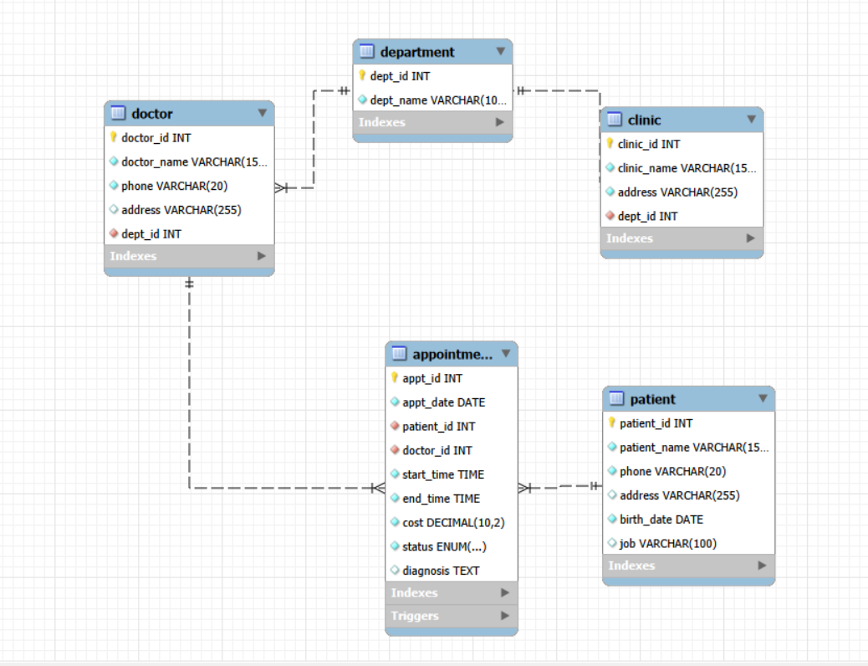
ERD
Relationships & Normalization
Main relationships
Department → Clinics: one-to-many
Department → Doctors: one-to-many
Patient → Appointments: one-to-many
Doctor → Appointments: one-to-many
Normalization coverage
1NF: atomic values.
2NF: no partial dependency.
3NF: non-key attributes depend on the primary key.
BCNF: determinants are candidate keys or superkeys.
Entity-Relationship Diagram from the report
06
Notes:
6

Slide 7
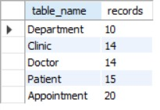
MySQL Workbench Implementation
SQL Implementation & Sample Data
10
14
14
15
20
Departments
Clinics
Doctors
Patients
Appointments
Submitted SQL Files
create_tables.sql
Creates the database, tables, constraints, indexes, and views.
load_data.sql
Inserts sample records into the database.
queries.sql
Includes retrieval, aggregation, reporting, and update queries.
Loaded sample records in MySQL Workbench
triggers.sql
Creates triggers for scheduling and workflow rules.
Sample data was loaded in MySQL Workbench and used to test views, queries, triggers, and the web application connection.
07
Notes:
7

Slide 8
Constraints
Data Integrity & Design Decisions
01
Primary Keys
02
Foreign Keys
03
Unique Rules
Unique record identity for every table: Department, Clinic, Doctor, Patient, and Appointment.
Department name, doctor phone, and patient phone are kept unique to avoid duplicates.
Ensure each appointment is connected to an existing patient and doctor.
04
Check Rules
05
ENUM Status
06
ON DELETE RESTRICT
End time after start time, non-negative cost, and valid birth dates.
Limits status to scheduled, completed, in_progress, postponed, and cancelled.
Protects medical history by preventing accidental deletion of doctors or related records.
Key design choices
Doctors are linked to departments because specialty is more important than clinic location.
Surrogate integer primary keys were used because names and phone numbers can change.
Diagnosis allows NULL because it is added after consultation.
08
Notes:
8

Slide 9
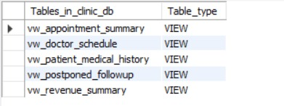
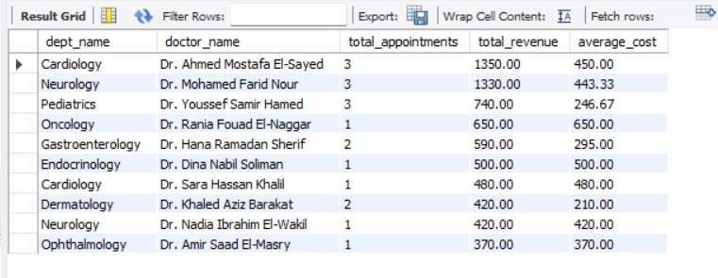
Reporting Layer
Views & Reporting
Why views were created
Views simplify long JOIN queries and provide ready-to-read reports for reception, doctors, administrators, and financial reporting.
Five database views
1
Appointment summary
2
Patient history
3
Doctor schedule
Revenue summary
4
vw_appointment_summary
Readable appointment list with patient, doctor, department, cost, status, and diagnosis.
Appointment revenue grouped by department and doctor.
vw_patient_medical_history
Patient profile with age, visits, payments, last visit, and latest diagnosis.
Upcoming and in-progress appointments for daily schedule management.
5
Postponed follow-up
Postponed appointments with patient contact information for rescheduling.
Revenue summary query output
09
Notes:
9

Slide 10
Required Project Questions
SQL Queries & Required Questions
The system supports medical, administrative, and financial retrieval through SQL queries and views.
Q1
1. Prevent overlapping appointments
Q2
2. Patient summary + appointment history
Q3
3. Upcoming appointments next month
Use a BEFORE INSERT trigger on Appointment. It checks the same doctor, same date, and time interval. If a conflict exists, the database rejects the insert.
Start from Patient, then LEFT JOIN Appointment, Doctor, and Department to show patient details, visits, status, cost, and diagnosis.
Join Doctor, Department, and Appointment; filter next month; count appointments per doctor.
GROUP BY d.doctor_id, d.doctor_name, dep.dept_name
Example query categories implemented
Disease tracking: fatty liver patients in the last year
Clinic lookup: cardiology clinic addresses
Financial reporting: patient payments over three years
Workload/revenue analysis by doctor and department
10
Notes:
10

Slide 11
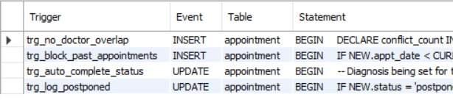
Database-Level Logic
Triggers & Business Rules
Why triggers matter
Important rules are enforced inside MySQL, so the database stays protected even if data is inserted manually or the application layer fails.
Triggers created in MySQL
1
trg_no_doctor_overlap
2
trg_block_past_appointments
Rejects overlapping appointments for the same doctor.
Prevents scheduling new appointments in the past.
3
trg_auto_complete_status
4
trg_log_postponed
Automatically sets status to completed when diagnosis is entered.
Stores postponed status changes in Appointment_Audit for follow-up.
11
Notes:
11

Slide 12
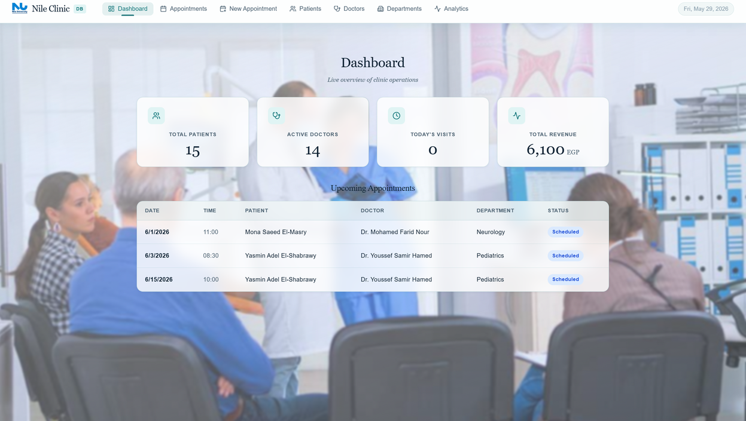
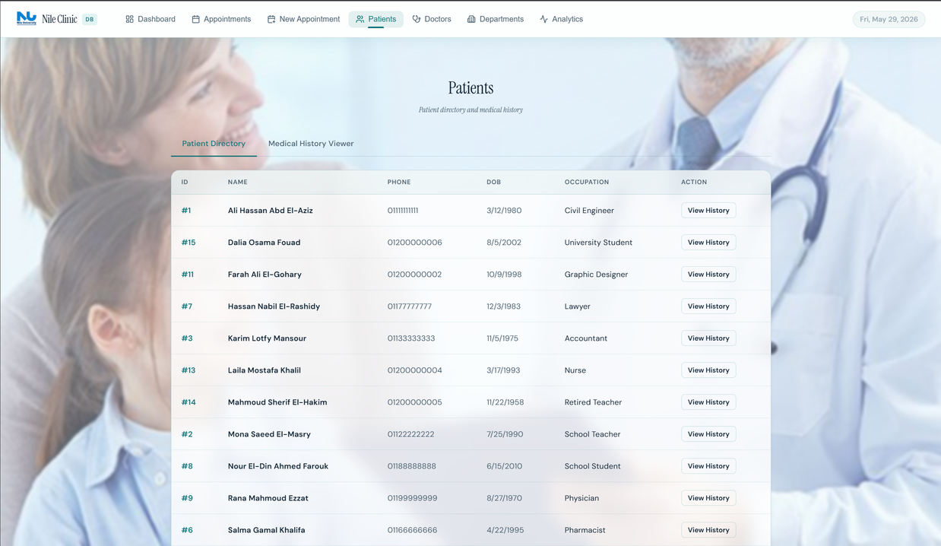
Final System
Web Application, Testing & Conclusion
Three-layer structure
Frontend: React/Vite → Backend: Node.js/Express → Database: MySQL clinic_db
Testing covered
Tables created and sample data loaded
Views generated and displayed
Web dashboard connected to MySQL
Revenue and reporting queries executed
Triggers tested for overlap, past dates, auto-completion, and audit logging
Web app connected to MySQL and displayed database results
Conclusion
Patient directory displayed in browser
12
Notes:
12

Slide 13
THANK YOU!
13
Notes:
7

